Slide 1

expanding
Sustainable Aquaculture to help meet MDGs
partnership . excellence . growth

Slide 2
aquaculture
global fish production
one of the most innovative and rapidly growing food sectors
  technical developments
  market opportunities
  investment
majority of aquatic foods
  food security
provides opportunities for millions
  120 million directly dependent upon aquaculture
80
70
capture
60
50
million tonnes
40
30
20
10
culture
0
1970
1980
1990
2000
2010
source: FAO
year
*based on FAO estimates for 2007; (FAO, 2009)

Slide 3
aquaculture and economic growth
wider economy and other beneficiaries
produce aqua-feeds
transport fry, fish &
feeds
access to
affordable fish
operate a hatchery
produce fish
fish trader
seed
feed mill
farmer
transporter
retailer
consumer
feedstuffs
grow feed
ingredient crops

Slide 4
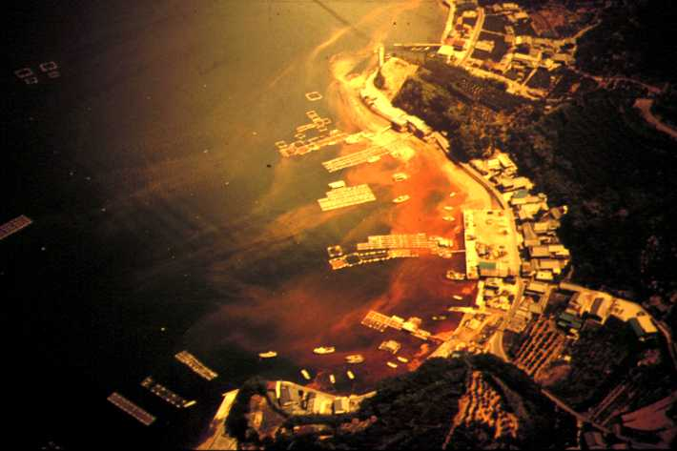
but …
can production meet growth in demand?
  rate of aquaculture growth slowing
impacts of expansion, intensification and globalization
  makes unsustainable demands on the environment
  perpetuates/aggravates inequity and social exclusion
    can the poor benefit from engaging in aquaculture production?
  susceptible to climate change, increasing vulnerability
red tide, Inland Sea, Japan

Slide 5
our Mission and
Development Challenge for
Sustainable Aquaculture

Slide 6
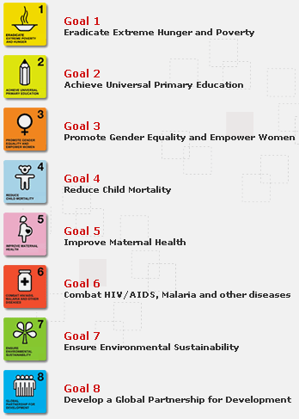
our Mission
to reduce poverty and hunger by improving fisheries and aquaculture
focus our work to maximize the impact of aquaculture on the MDGs
this means specifying
  our research focal areas
  where in the world we will be active
  who we will partner with
… and what we will not do

Slide 7
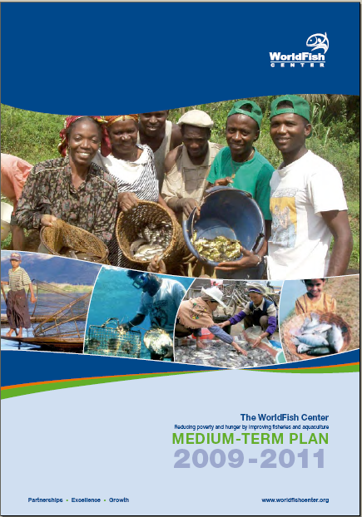
our Development Challenge
Sustainable Aquaculture
provides food, nutrition and economic opportunity for those who most need it
uses ecosystem services wisely and efficiently, avoiding the accumulation of environmental problems for the future
is integrated into national economies in ways that maximize its development impact

Slide 8
Roadmap for our Sustainable Aquaculture Development Challenge

Slide 9
Development Challenges and MTPs
cross-cutting issues
gender
impact
Sustainable
Aquaculture
Resilient Small-
Scale Fisheries
Markets
And
Trade
Productive
Technologies
Resilience
In
Practice
Environment
Governance
Global
Drivers
MTP project content
each project comprises
sub-projects

Slide 10
how we are organized
three Disciplines - Natural Resources Management (NRM); Policy, Economics and Social Sciences (PESS); Aquaculture (AQ)
Location | Name | Staff Position | 2004 | 2005 | 2006 | 2007 | 2008 | 2009
Bangladesh | Johannes 'Hans' Janssen | Senior Aquaculture Scientist | 1 | 1
Bangladesh | Naseem Aleem | Field Coordinator IAA | 1 | 1
Egypt | George John | Senior Aquaculture Scientist | 1 | 1 | 0.75
HQ | A.G. Ponniah | Discipline Director | 1 | 1 | 0.25
HQ | Mark Prein | Program Leader | 1 | 1 | 0.25
Bangladesh | Benoy Berman | Coordinator, DRRP | 1 | 1 | 1 | 1 | 1 | 1
Cameroon | Randall Brummett | Senior Aquaculture Scientist | 1 | 1 | 1 | 1 | 1 | 1
Egypt | Abdel Rahaman El-Gamal | Senior Aquaculture Scientist | 1 | 1 | 1 | 1 | 1 | 1
Egypt | Gamal Othman El-Naggar | Research Co-ordinator | 1 | 1 | 1 | 1 | 1 | 0.5
Egypt | Mahmoud Ali Rezk | Researcher /Genetics | 1 | 1 | 1 | 1 | 1 | 1
Egypt | Salah M. Aly | Aquaculture scientist | 1 | 1 | 1 | 1 | 1 | 0.75
HQ | Raul Ponzoni | Principal Scientist | 1 | 1 | 1 | 1 | 1 | 1
Malawi | Daniel Matthews Jamu | Regional Director | 1 | 1 | 1 | 0.5 | 0.5 | 1
Egypt | Malcolm Beveridge | Discipline Director |  |  | 0.75 | 1 | 1 | 1
Malawi | Lars Windmar | Rural Development Specialist |  |  | 0.75 | 1 | 1 | 0.25
HQ | Nguyen Hong Nguyen | Scientist |  |  | 1 | 1 | 1 | 1
HQ | Fred Weirowski | Advisor |  |  |  |  | 1 | 1
HQ | Jharendu Pant | Aquaculture Scientist |  |  |  |  | 0.67 | 1
HQ | Curtis Lind | Geneticist |  |  |  |  |  | 0.9
HQ | Mike Phillips | Senior Aquaculture Scientist |  |  |  |  | 0.13 | 1
 |  | Total AQ | 13 | 13 | 11.8 | 10.5 | 12.3 | 13.4
Region | Country | AQ staff
Asia | Mekong | -
 | Bangladesh | 1
 | Penang | 5.9
total |  | 6.9
Africa | Malawi | 1.25
 | Cameroun | 1
 | Egypt | 4.25
total |  | 6.5

Slide 11
our MTP

Slide 12
MTP 4 – sustainable aquaculture technologies
Goal
Increased productivity, resilience and development impact
of smallholder and SME aquaculture-based livelihoods
Sustainable
Aquaculture
Resilient Small-
Scale Fisheries
Productive
Technologies
Markets
And
Trade
Resilience
In
Practice
Environment
Governance
Global
Drivers
Objectives
to provide well-designed technologies for sustainable aquaculture, targeted at groups where development impacts can be maximized
to increase availability of quality seed for key aquaculture species, while conserving genetic resources
to increase availability of aqua-feeds and develop feeding systems that maximize profitability, are consistent with an ecosystem-based approach to aquaculture development and produce nutritionally sound aquaculture products

Slide 13
MTP 5 – aquaculture and the environment
Goal
Adoption of aquaculture that benefits the poor and makes
better use of ecological services without unacceptably
compromising ecosystem structure and function
Sustainable
Aquaculture
Resilient Small-
Scale Fisheries
Productive
Technologies
Markets
And
Trade
Resilience
In
Practice
Environment
Governance
Global
Drivers
Objectives
to strengthen capacity to assess the relationship between water productivity and aquaculture
to inform policies and management practices for the uptake of sustainable aquaculture
to minimize risks associated with developing and disseminating genetically improved strains of farmed aquatic animals
to connect consumers to small-scale producers and promote the adoption of best environmental management practices

Slide 14
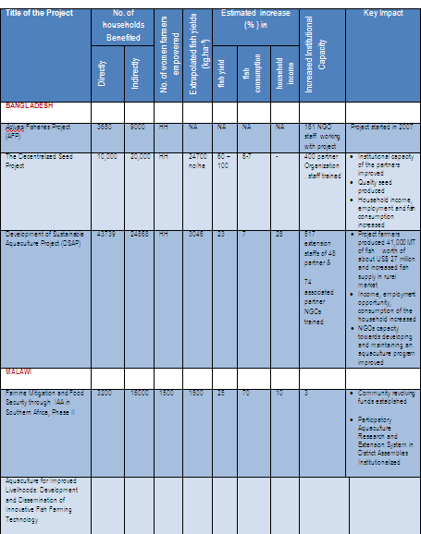
in practice ….
working in some 15 countries
working with dozens of partners (ARIs, NARs, NGOs)
participating in some 25 research/ development projects
impacting on household incomes, nutrition,
building capacity
producing dozens of IPGs
  research papers, policy briefs, genetically improved strains

Slide 15
some key challenges

Slide 16
balance our research portfolio
relative importance of project
portfolio drivers
three drivers of project portfolio recognized
  funding opportunities at country level
  strategic choices in the develop-ment of the sub-sector at country level
  defining a global research agenda for aquaculture in developing countries
strategic drivers should play a greater role
how to secure research funds?
global
global
strategic
strategic
country
country
where
we’ve come
from
where
we want
to be

Slide 17
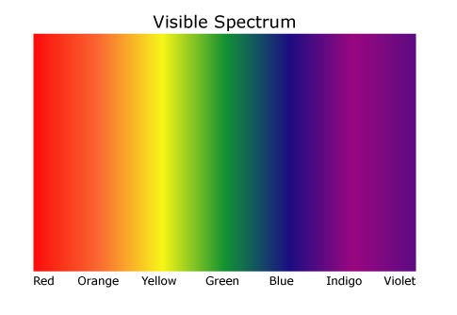
determine our target groups
to maximize impacts of Sustainable Aquaculture on the poor we must focus on
less poor producers
chronic poor are best helped through facilitating engagement in other parts of the
market chain
… but we need a globally coordinated research agenda to test this
large-scale
commercial
indirect
IAA
SMEs
direct
IAA
extensive
semi-intensive
intensive
present focus
our proposed future focus

Slide 18
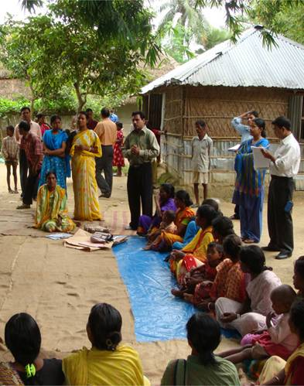
develop an extension research agenda
we need a globally integrated research agenda that determines how to most effectively - and cost effectively – scale out sustainable, productive aquaculture technologies in different contexts
  incl. mechanisms to multiply and disseminate genetically improved strains

Slide 19
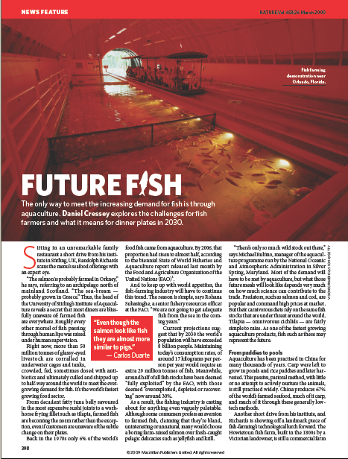
… and finally
aquaculture has the potential to sustainably meet the gap between supply and demand for aquatic foods
at the same time, it has the potential to lift substantial numbers of poor people out of poverty
needs clearly articulated research agenda and support to implement it

